Slide 1

1.- Look at A opposite. Which input device would you use for these tasks?
to play computer games -----> Keyboard and mouse or a Joystick
to copy images from paper into a computer -----> Scanner
to read price labels in a shop -----> Barcode reader
to select text and click on links on web pages -----> Mouse or Touchpad
to enter drawings and sketches into a computer -----> Graphics tablet or a Lightpen
to input voice commands and dictate text -----> Microphone
to draw pictures or select menu options directly on the screen -----> Touch Screen or a graphics tablet
to take and store pictures and then download them to a computer -----> digital camara or a webcam
Renzo Neyra Quesquen

Slide 2
2.- Complete each sentence by choosing from the following devices: touch screen, trackball, touchpad, webcam.
A Trackball is a stationary device that works like a mouse turned upside down. You roll the ball with your hand to move the pointer on the screen.
Interactive Touch screens are used in museums, information centres and Internet kiosks. You use your finger to point directly to objects on the screen.
A Webcam is used to send live video images via the Internet.
A touchpad with a finger is found on notebook PCs. You use it by pressing the sensitive pad
Renzo Neyra Quesquen

Slide 3
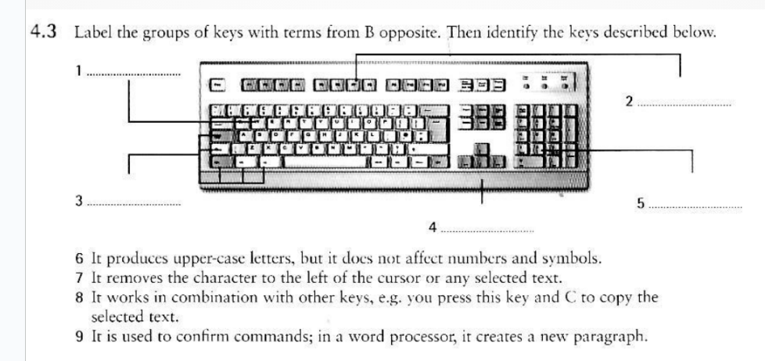
3.- Label the groups of keys with terms from B opposite. Then identify the keys described below
6 It produces upper-case letters, but it does not affect numbers and symbols. Shift Key
7 It removes the character to the left of the cursor or any selected text. Backspace Key
8 It works in combination with other keys, e.g. you press this key and C to copy the selected text. (CTRL)
9 It is used to confirm commands; in a word processor, it creates a new paragraph. Enter Key
Alphanumeric
Keys
Function Keys
Renzo Neyra Quesquen
Dedicated keys
and caps lock
Numeric keypad
Cursos keys

Slide 4
4.- Look at C opposite. Complete these sentences with the correct 'mouse action’.
To start a program or open a document you double click on its icon- that is, you rapidly press and release the mouse button twice.
If you want to select a menu option, you just click on the left button.
If you want to find the commands for a particular text, image, etc., you have to right-click on it.
If you want to move an object, press the button and drag the object to the desired location.
Renzo Neyra Quesquen

